Slide 1


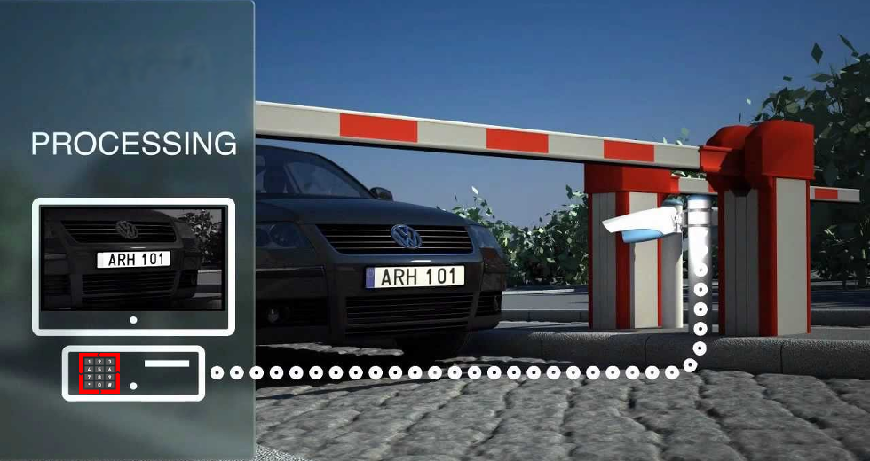
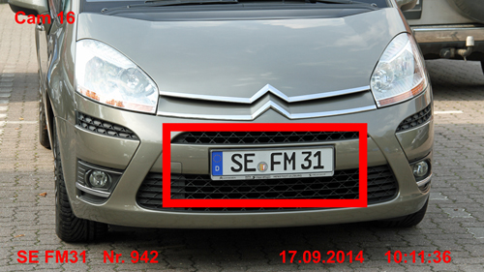
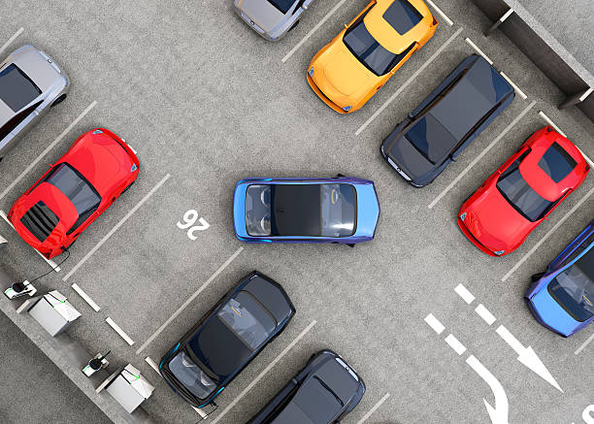
SMART PARKING SYSTEM
ACADEMIC YEAR 2021-2022

Slide 2
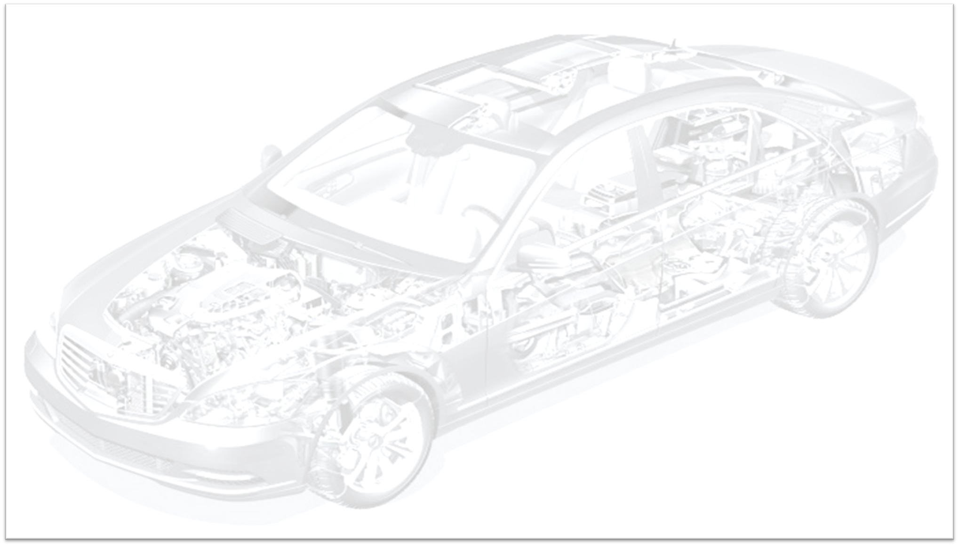
PRESENTED BY:
Alaa Gabr Abdul Baki.
Mariam Youssef Mohammed.
Mariam Hesham Salah El-Deen.
Nariman El-Sayed Mohammed.
Alaa Abdul Wahab Eid .
Hager Mohamed Ibrahim.
SUPERVISED BY:
DR: USAMA ABDELFATTAH
DR: AHMED ZAKZOUK

Slide 3
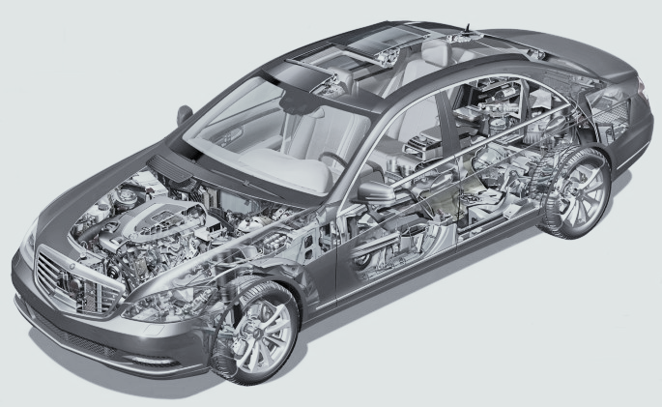
Agenda
• Introduction
• Plate detection
• Plate recognition
• Web Services
• Slots system
• Web services on the slots system
• Future Work

Slide 4

Introduction

Slide 5
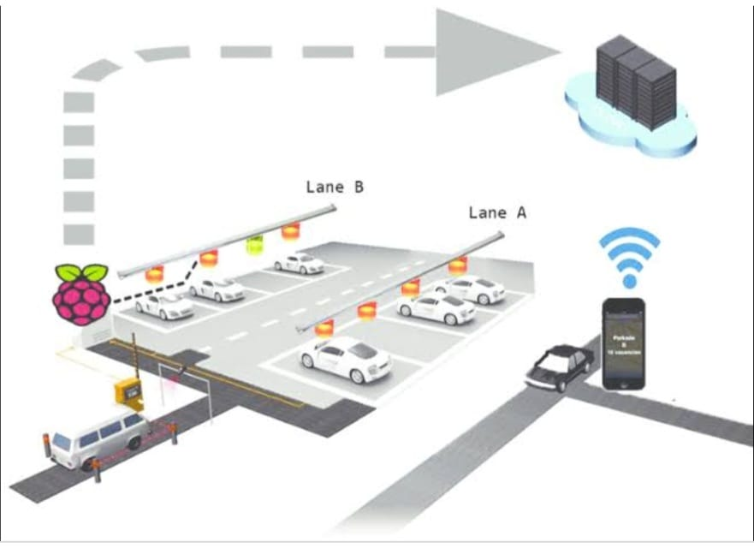
Figure 1.2

Slide 6
Disadvantage of not smart parking system .
1. congestion.
2. wasting time.
3. sometimes it is harmful to human health.

Slide 7
Need for project, why smart?
In this advanced world and many technology nowadays a regular garage is convenient, we see around us arising smart cities and compounds that uses smart technologies and iot throughout the city . So we thought that in these cities we also need a compatible smart garage to be suitable for these cities.
Also, in this hurried world we need a less wasteful garage.
and a system that makes parking easy for you.

Slide 8
Motivation to use Smart parking
1-Smart Parking System like this helps drivers make smart decisions which will reduce congestion.
2-Consumption of Less Fuel.
3-Cost and Time Efficient Solution.
4-Reduce Parking Stress.
5-Reduce Search Traffic on Streets.
6-Increased Safety.

Slide 9
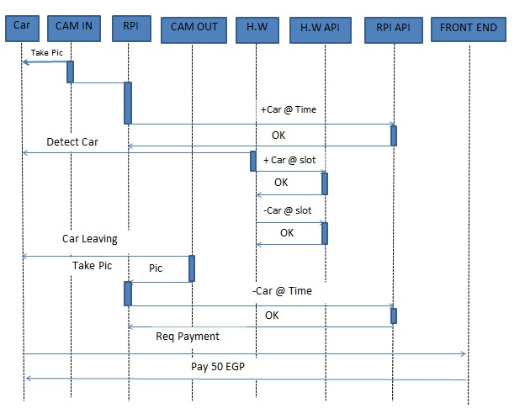
1.5:Project descriotion:

Slide 10
Plate detection and recognition

Slide 11
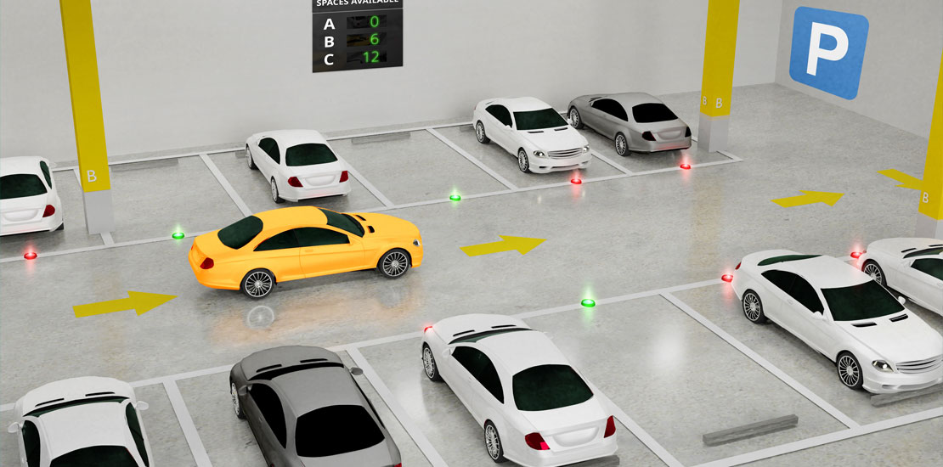

Slide 12
Ai part
The ticketless parking feature:
Of the entry of the car we capture the photo of the car by the camera then we begin our processing to get the plate number:
plate detection
Processing of image
1- plate detection
Intro:
We used AI technology to implement it.
AI has many fields we used computer vision principles which is responsible for deriving meaningful information from images.
Computer vision trains machines to perform the function of image detection.

Slide 13
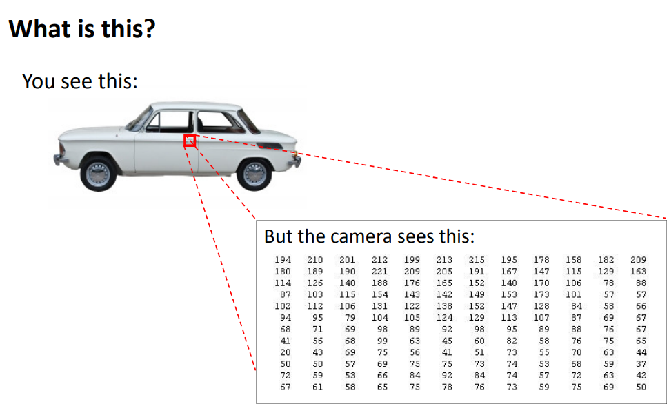
How computer vision works?
Computer vision:
needs at first a lot of data, it runs analyses of data over and over
until the algorithm is able to recognize images.
Example:
to get car plate from car image
to do it:
We use deep learning and neural network it helps a machine learning or deep learning model “look” by breaking images down into pixels that are given tags or labels.
Why is it hard to recognize something from a photo?

Slide 14
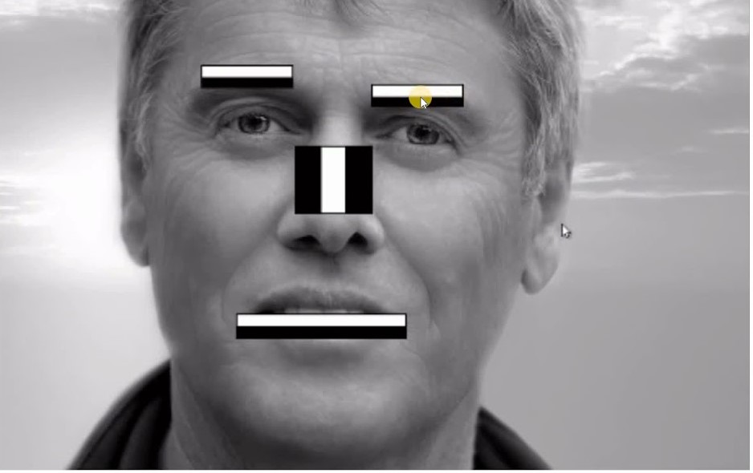
Algorithm we used:
Haarcascade: It is an Object Detection Algorithm used to identify faces in an image or a real-time video.
1- we load the trained data to it has various of trained data, face detection, smile detection and plate detection.
2- the computer is now trained to recognize the plate from the image we upload to it.
A look in how the algorithm think.

Slide 15
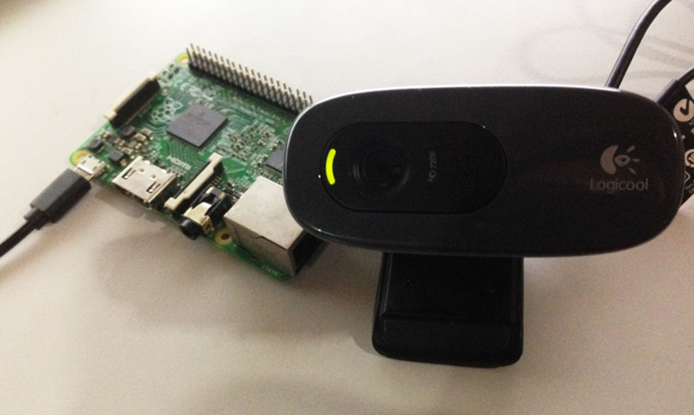
Hardware of ticketless parking:
1- camera:
To take pictures of the cars when entering and exiting.
2- Raspberry pi:
To run the code on it and connect the cameras.
How to connect it?
It needs a power supply and an ethernet jack to connect it to pc.
PS. We use pc here as a screen for displaying the raspberry pi.

Slide 16

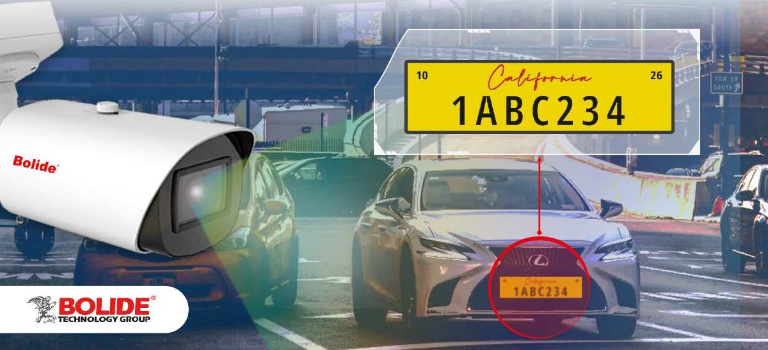
Steps for plate detection:
1- we get a trained data
2- we gave it to the function “detect multiscale” to be able to recognize the plate
3- the function returns an array of plates founded in the frame.
4- we take the largest plate sorted by the area and this is the plate image.

Slide 17
Software of the project:
1- plate recognition:
We coded in python and used opencv library for the part of detection.
A- we begin taking pictures of the camera frame by frame.
B- started by processing the image:
1- converting it to gray scale
2- resizing the image
3- smoothing the image and
removing noise.
.

Slide 18
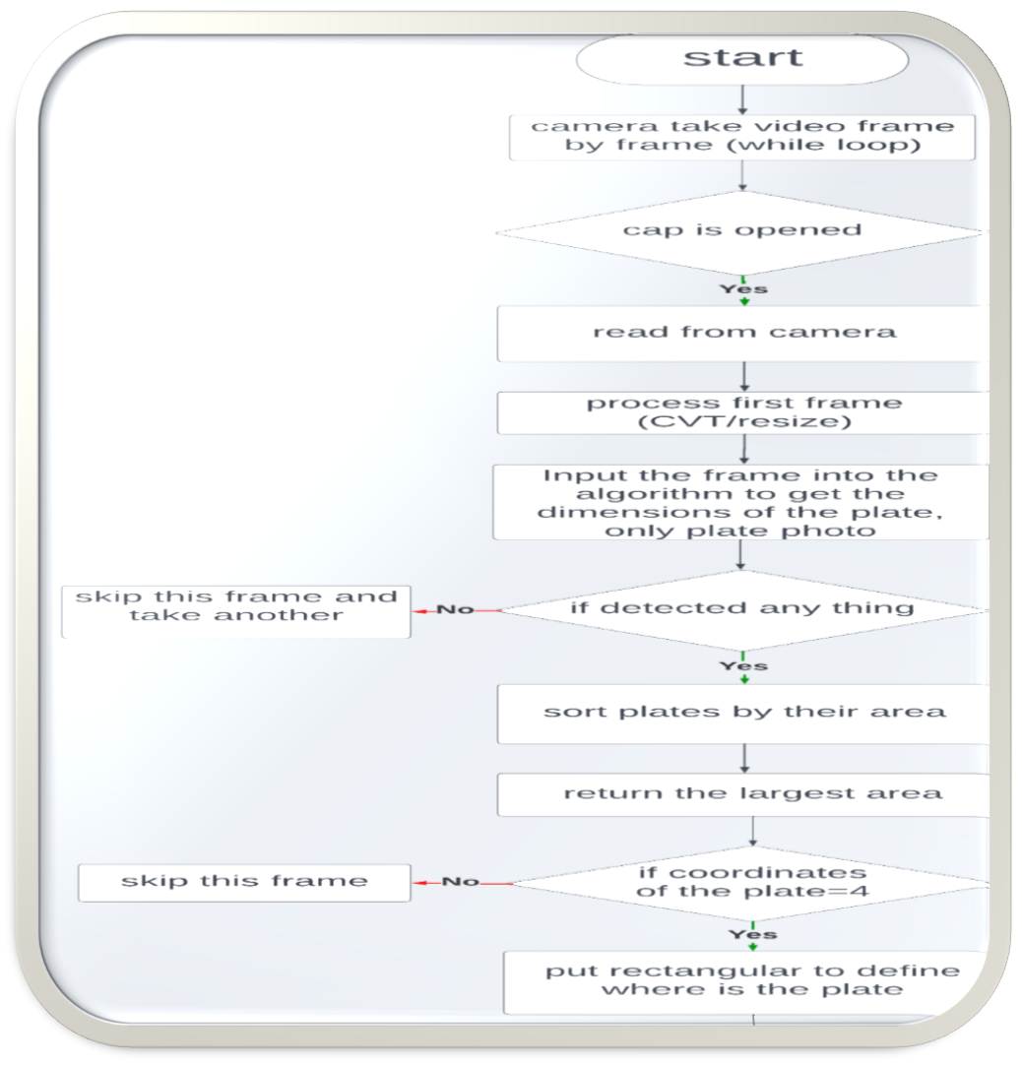
flow chart of plate detection

Slide 19
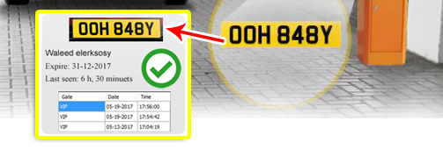
2: Extracting Characters and numbers from the license plate image
License plate detection and recognition is the technology that uses computer vision to detect and recognize a license plate from an input image of a car
When the car enters parking lot we capture the image of the plate, we perform image processing methods on the captured image. We then find the contours of the plate and crop the image along those contours. The processed image is then fed to tesseract algorithm for character recognition.

Slide 20

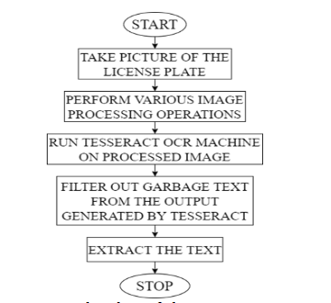
flow chart of plate recognition

Slide 21
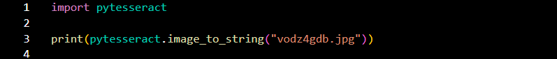
Implementation To read the text from an image the first step is to open the image. Next, to actually read the text from an image, you need to pass the image object you just opened to the image_to_string() method of the Pytesseract module. The image_to_string() method converts the image text into a Python string. We’re simply going to print the string to our screen using the print () method. Execute the following script to read the text from the car number plate image:

Slide 22
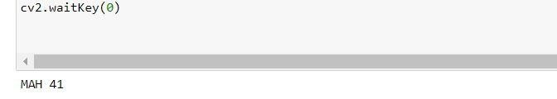
OUTPUT:

Slide 23
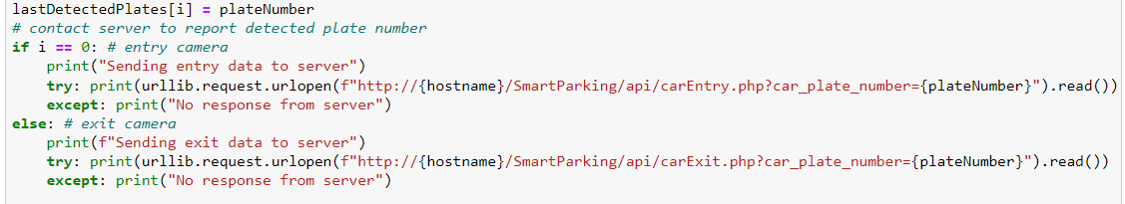
. then, contact server to report detected plate number and the data will be transferred to server.
By using urlib library.

Slide 24
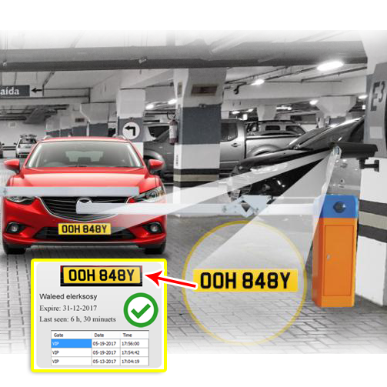
Overall look :

Slide 25
Web services

Slide 26
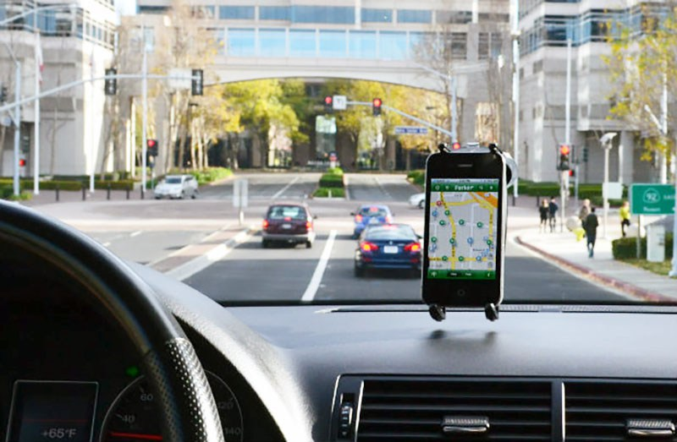
This Photo by Unknown Author is licensed under CC BY-SA-NC

Slide 27
Web services
Description
A web service has been developed to receive data from
embedded device through wifi module and show it.
Using this application the user (car owner) can know whether
there is a free location in the parking or not, also where is
the free location in the parking and the nearest route to park,
He also can know how much money he must pay if the car is
parked for a period of time in the parking.

Slide 28
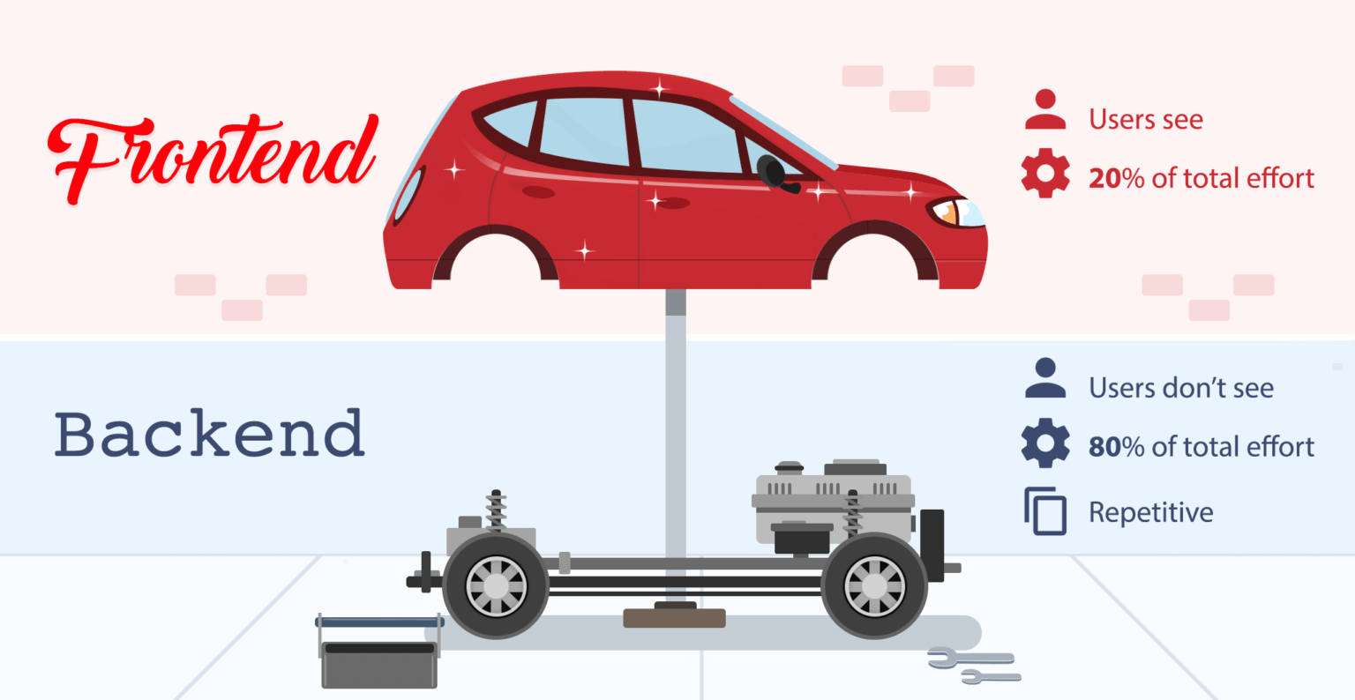
Background
Background
We should know some concepts, such as: Frontend and Backend
Backend development
It handle the functionality (behind-the-scenes) of web applications. It’s code powers the web application itself.
Frontend development
Refers to that area of web development that focuses on what the users see on their end.

Slide 29
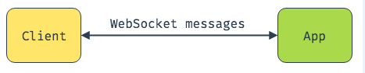
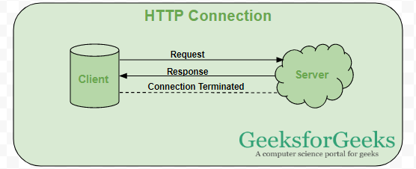
Communication Protocols
1- Web Socket is a bidirectional
communication protocol,
the connection is kept alive until
terminated
2- HTTP protocol is a
unidirectional communication
protocol. the connection is
terminated continuously.
We just need to send data and get
response, so we used the HTTP
protocol.

Slide 30
Block diagram for the web application
The embedded device in the cam
HTTP request
Plate Id
Backend
Save the received data
Frontend
Every check-out send http request
Send back data as a response

Slide 31
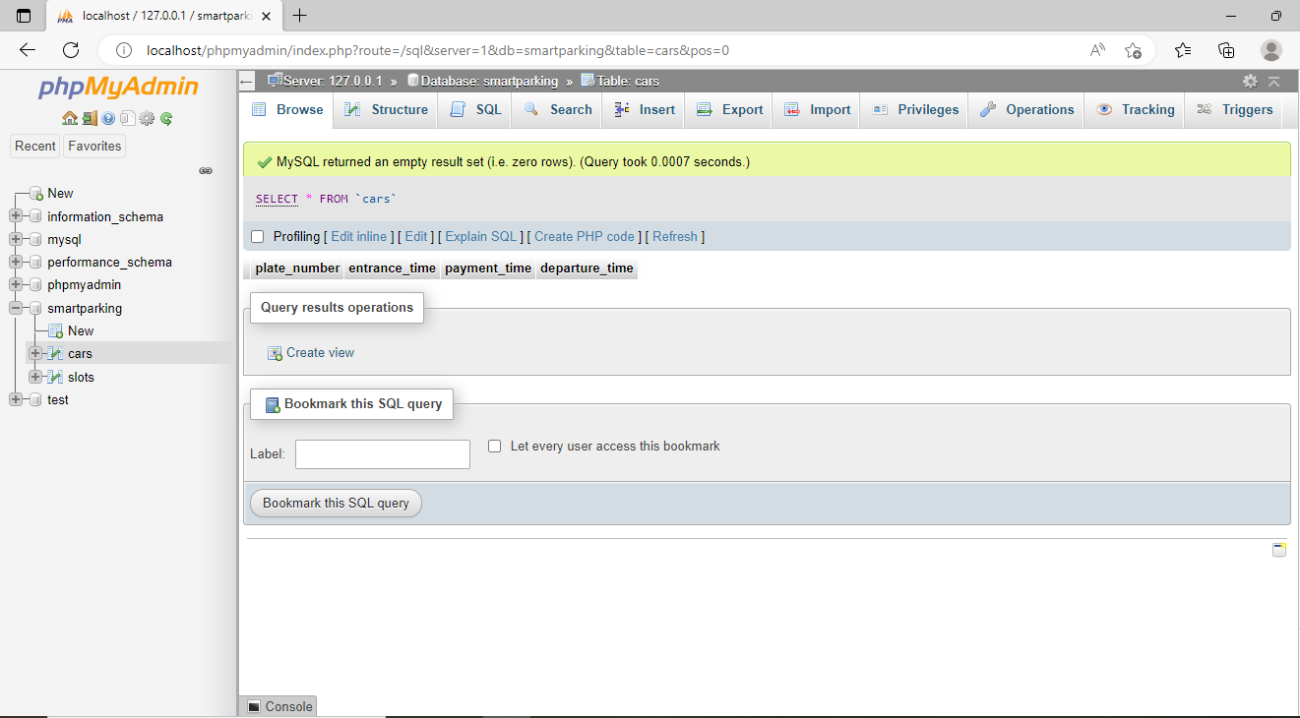

Slide 32
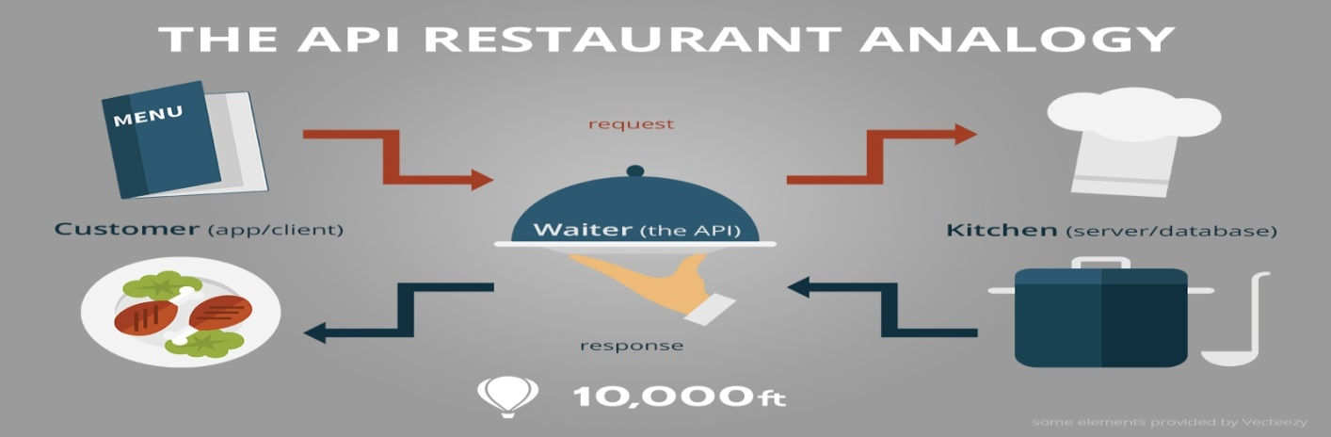
Backend Implementation
APIs
APIs are interfaces for
the frontend applications to connect to it,
run functions in the backend and access data.

Slide 33
Backend Implementation
API for receiving data:
When the front camera sends a http request to the next URL (https://localhost/smartparking/api/carEntry.php?car_plate_number={PlateNumber}), The plateNumber variable which captured by the camera, then the data be received and stored. such as follow :

Slide 34
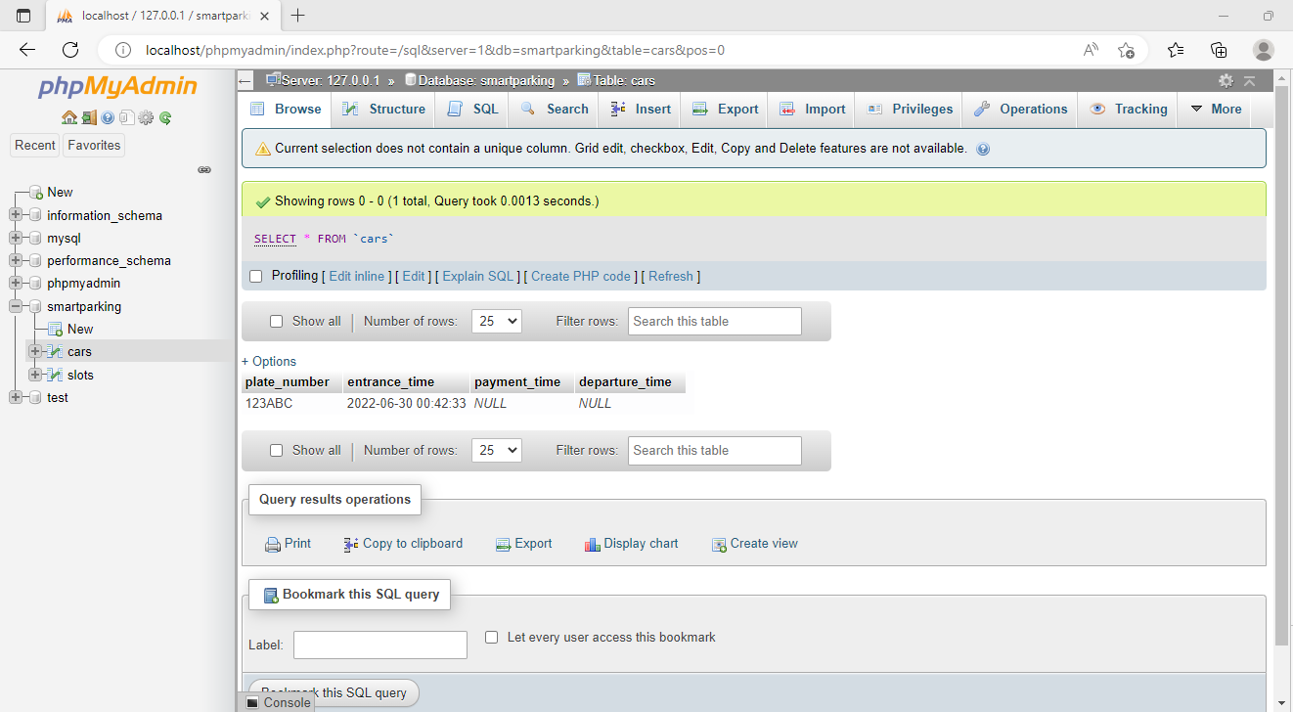
After receiving the data:

Slide 35
Backend Implementation
2nd API:
When the back camera sends a http request to the next URL (http://localhost/smartparking/api/carExit.php?car_plate_number={plateNumber}), The plateNumber variable which captured by the camera, then the data be received and stored. such as follow :

Slide 36
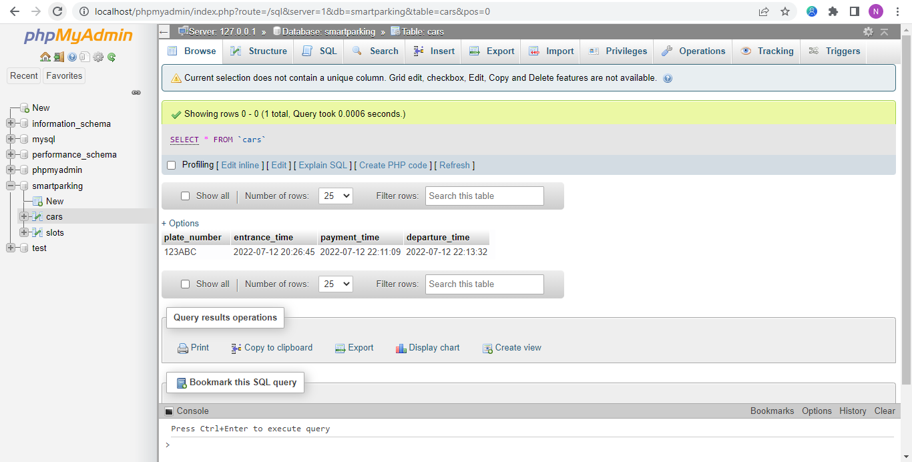

Slide 37
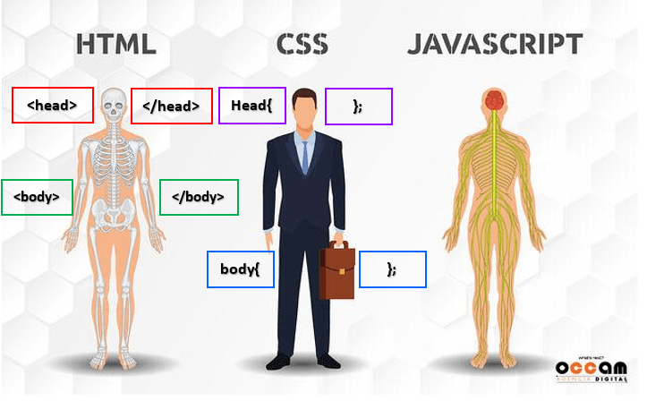
Frontend Development
Frontend development
Refers to that area of web development that focuses on what the users see on their end.
Web Technologies Involved in Frontend Development
1. HTML (building blocks and elements).
2. CSS (style and layout)
3. JavaScript(interactive with user.)

Slide 38
Frontend implementation
Main frontend functionality
The frontend runs the main function which contain 3 functions:
1- To have safe checkout, you can put your car plate number in input text in exit page of website.
2- Get the data and amount of time that the car with this plate number was parked in the parking from the backend.
3- Get the amount of money that the car with this plate number should be paid from the backend. and show thanking message.

Slide 39
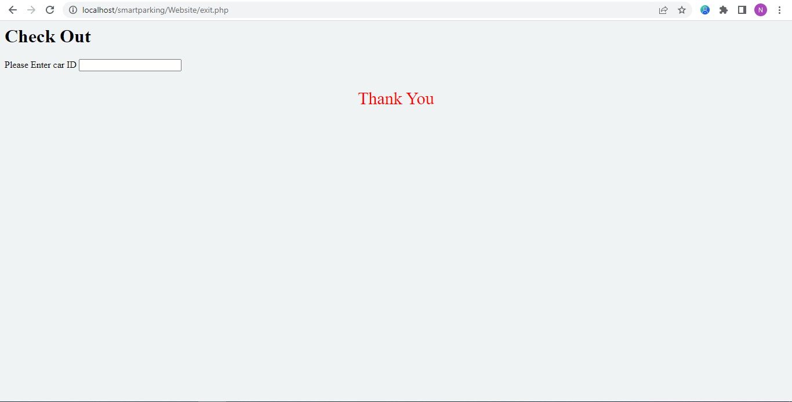

Slide 40
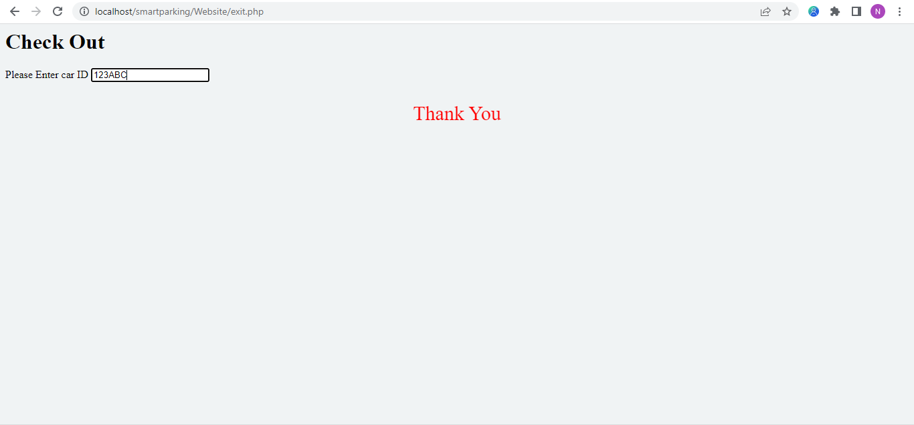

Slide 41
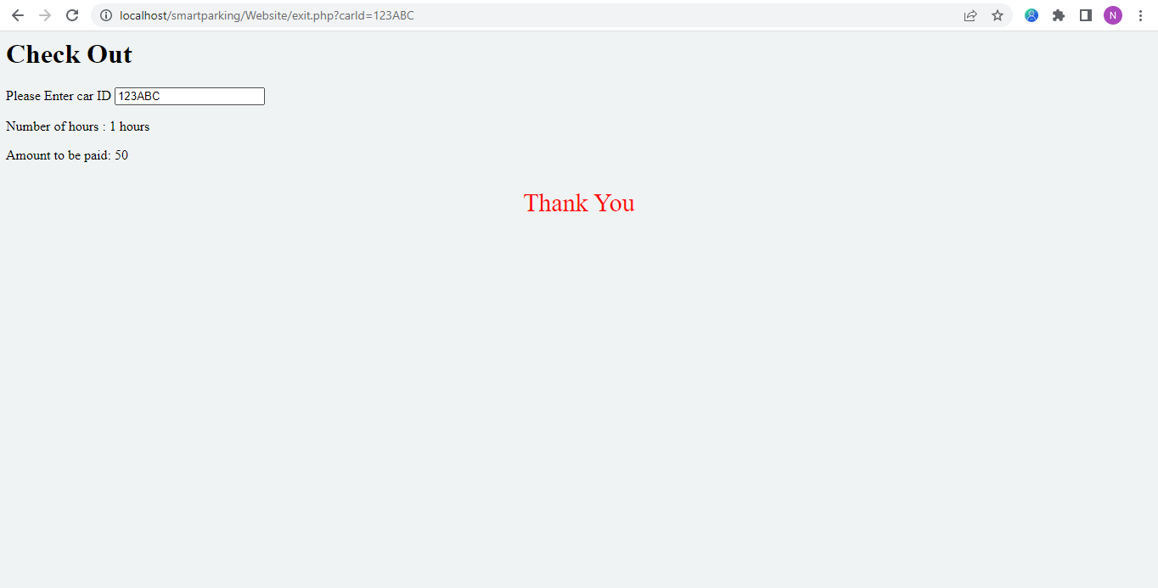

Slide 42


Slide 43
Frontend implementation
Frontend design
There are 3 pages in the website :
1. Start page: which shows how to go to the Services, Help and Contact pages

Slide 44
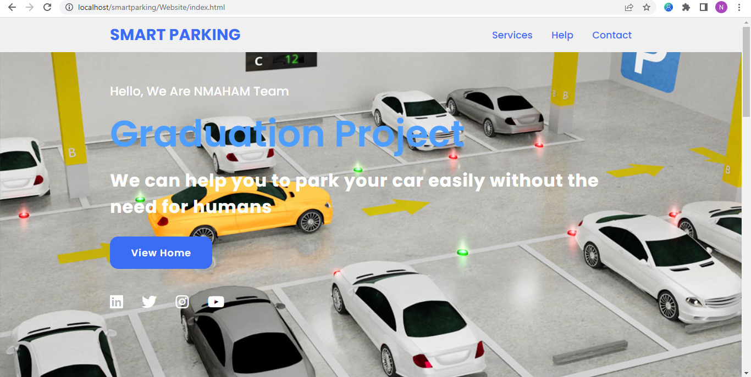

Slide 45
Frontend implementation
2.Services page:
which shows the free and busy locations when owner’s car clicks the Entry button. and shows the time taken and the money to be paid when owner’s car clicks the Exit button.

Slide 46
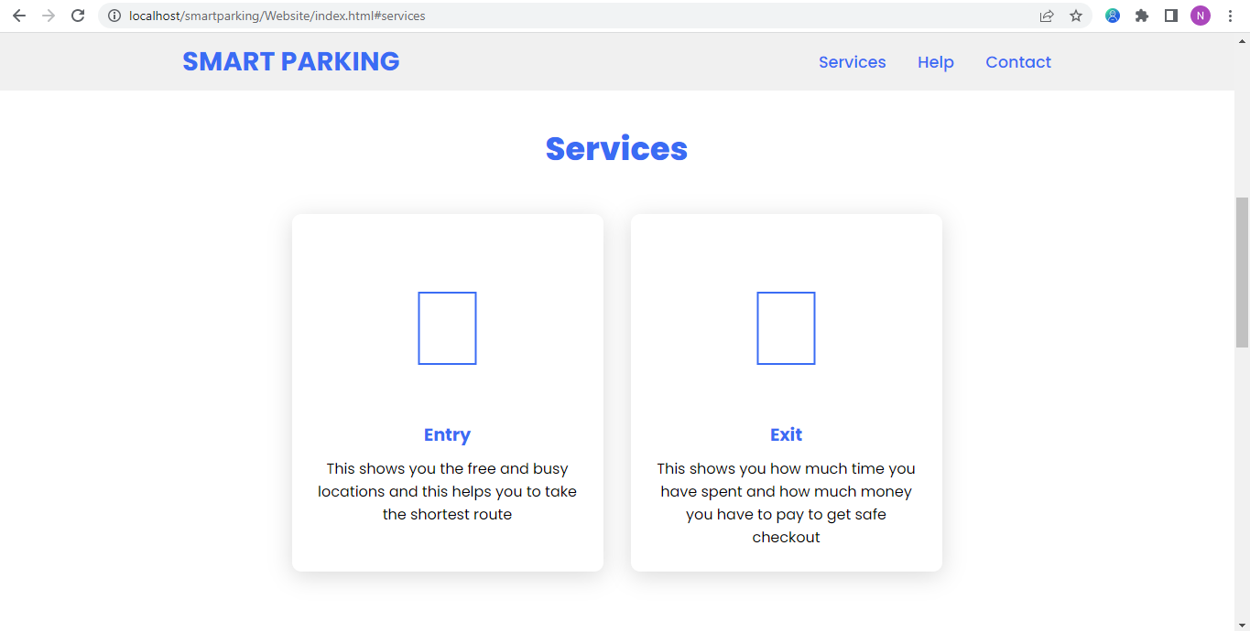

Slide 47
when car owner clicks the Exit button

Slide 50
Slot System

Slide 51


Slide 52
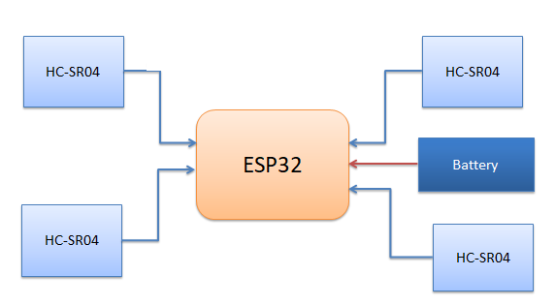
System main component

Slide 53
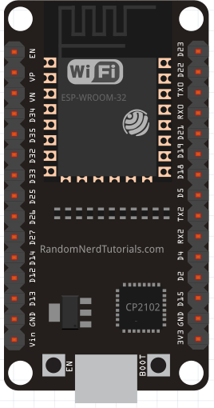
ESP32
wi-fi built in.
support I2C communication.
Small size.
Low cost

Slide 54
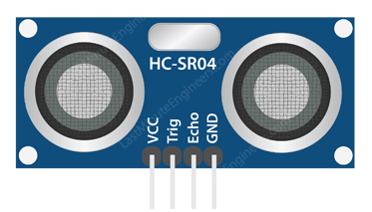
HC-SR04
Ultrasonic sensors are devices that use electrical–mechanical energy transformation.
use to measure distance from the sensor to the target object(car)
In our project we use it to detect the presence of a car in the spot to change the color of slot in deferent cases .

Slide 55
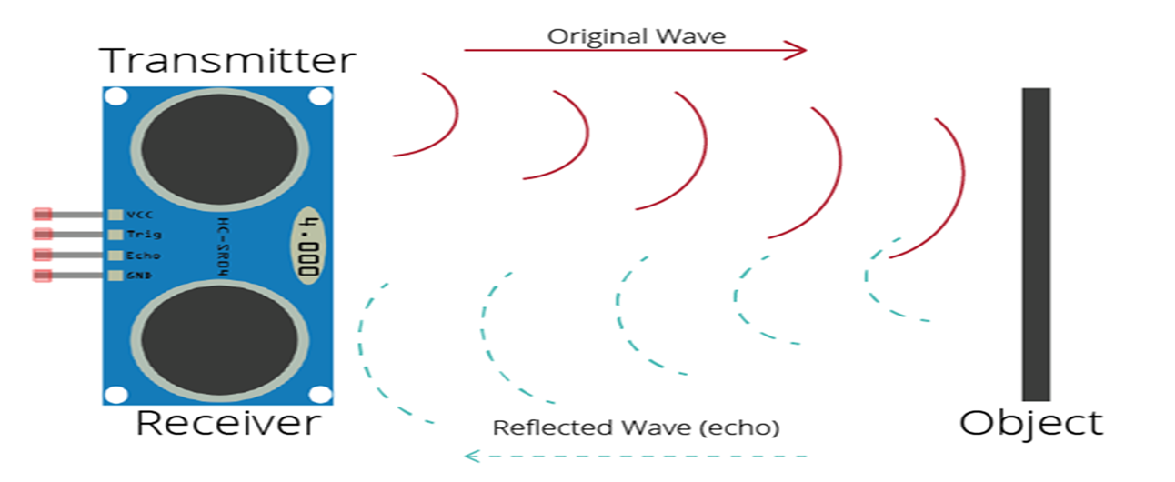
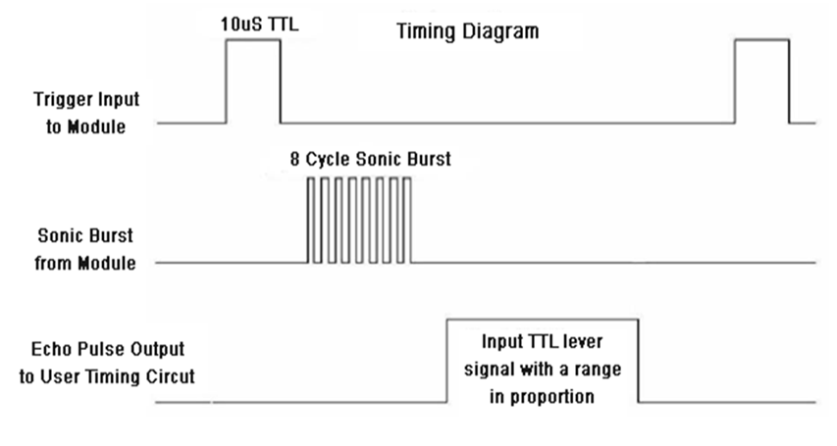
HOW It Work?
It emits short bursts of sound and listens for this sound to echo off of nearby objects.(40 kHz (ultrasonic))
The sensor measures the time of flight of the sound burst. then computes the distance to an object using the echo time and the speed of sound .

Slide 56

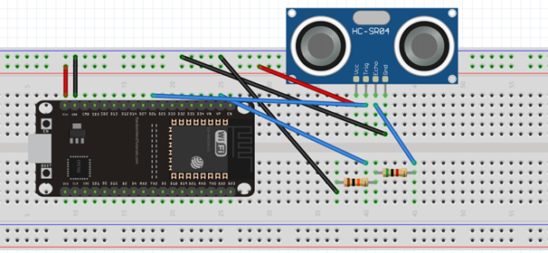
Connection Ultrasonic With ESP 32
Interfacing Ultrasonic With ESP 32

Slide 57
Code ESP32 with Ultrasoinc and upload data to Server

Slide 58
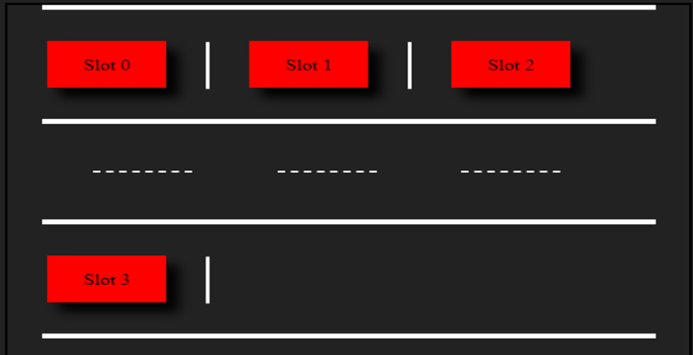

Slide 59
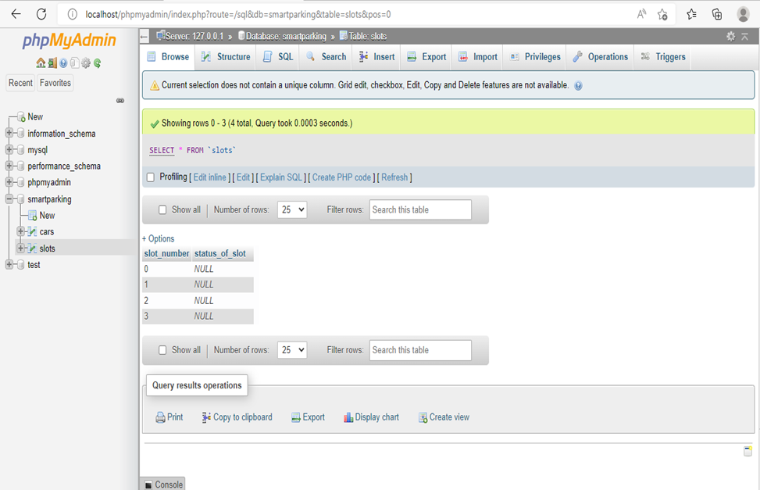

Slide 60
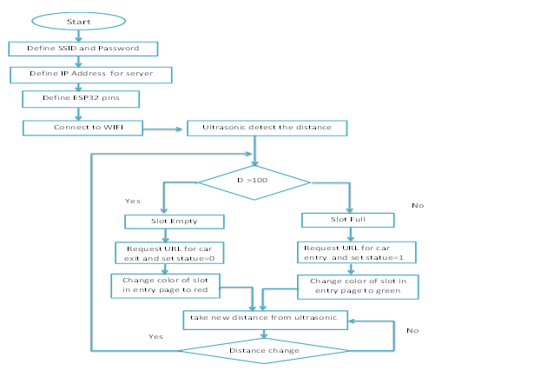

Slide 61
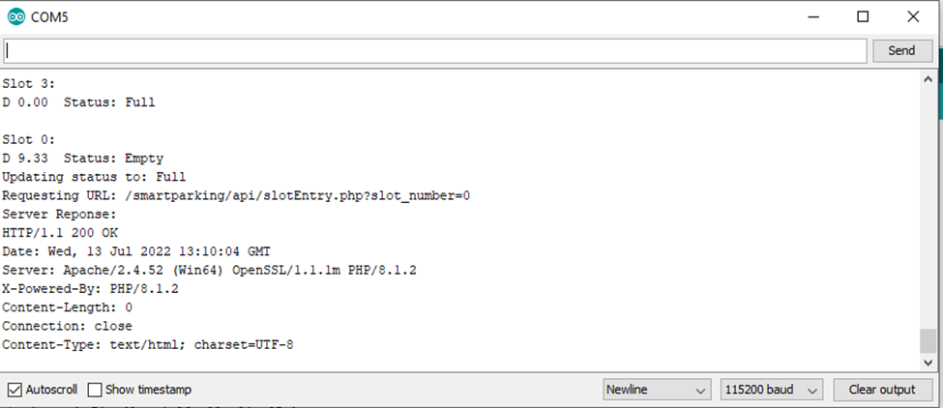

Slide 62
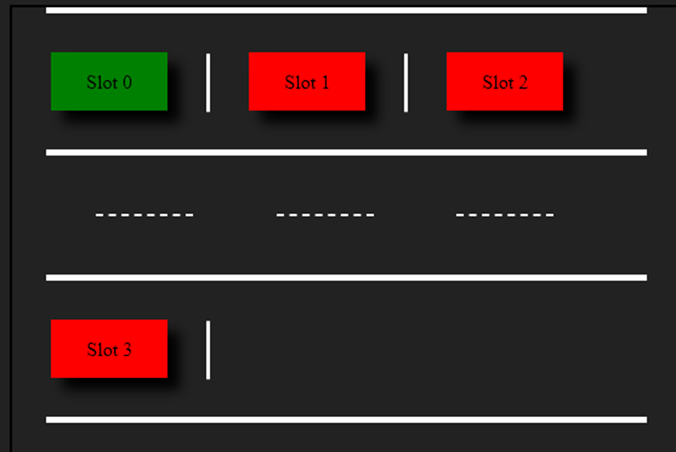

Slide 63
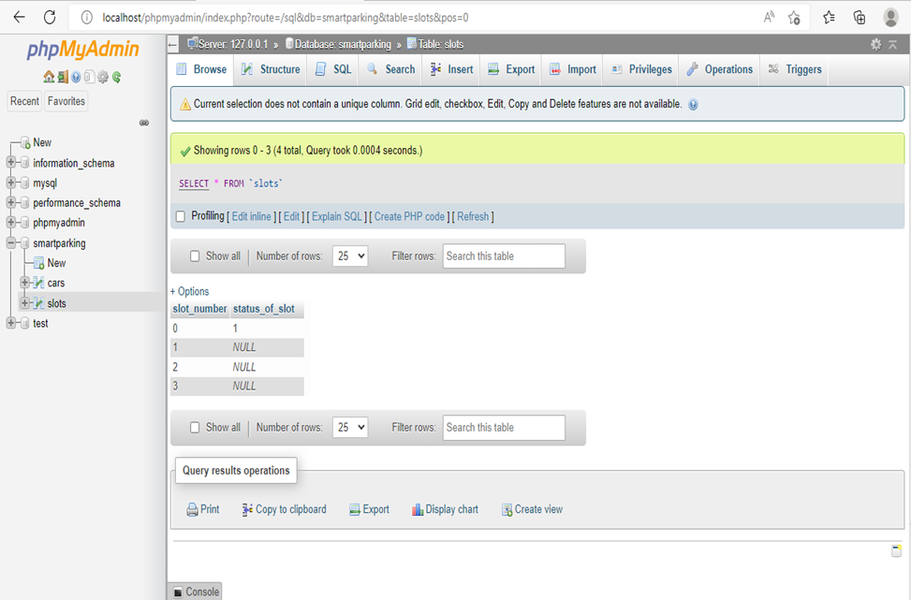

Slide 64


Slide 65
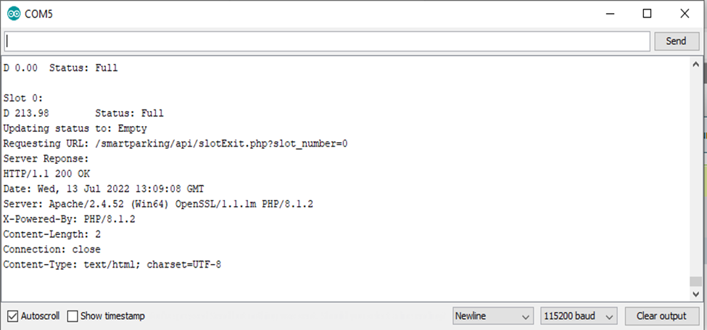

Slide 66


Slide 67


Slide 68
System Block Diagram
Laptop
(server)
HC-SR04
HC-SR04
ESP32
Battery
HC-SR04
HC-SR04
Router

Slide 69
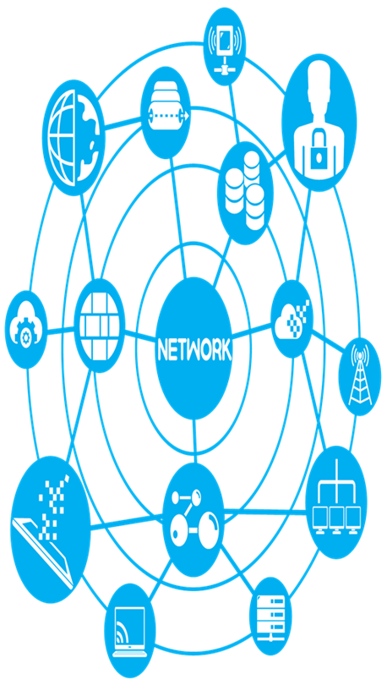
What is Network?
A network is a combination of hardware and software that sends data from one location to another.
there are many type of network devices we use two types from them:
Router
Access Point

Slide 70
Web Services on
Slots System

Slide 71
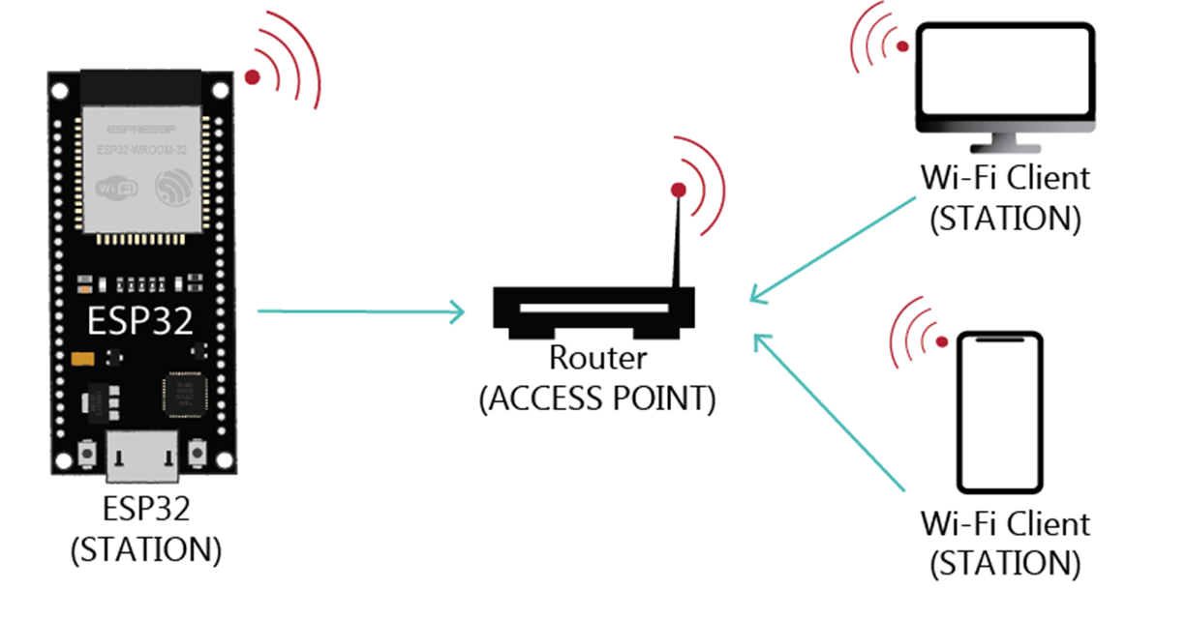
How data upload to the server?

Slide 72
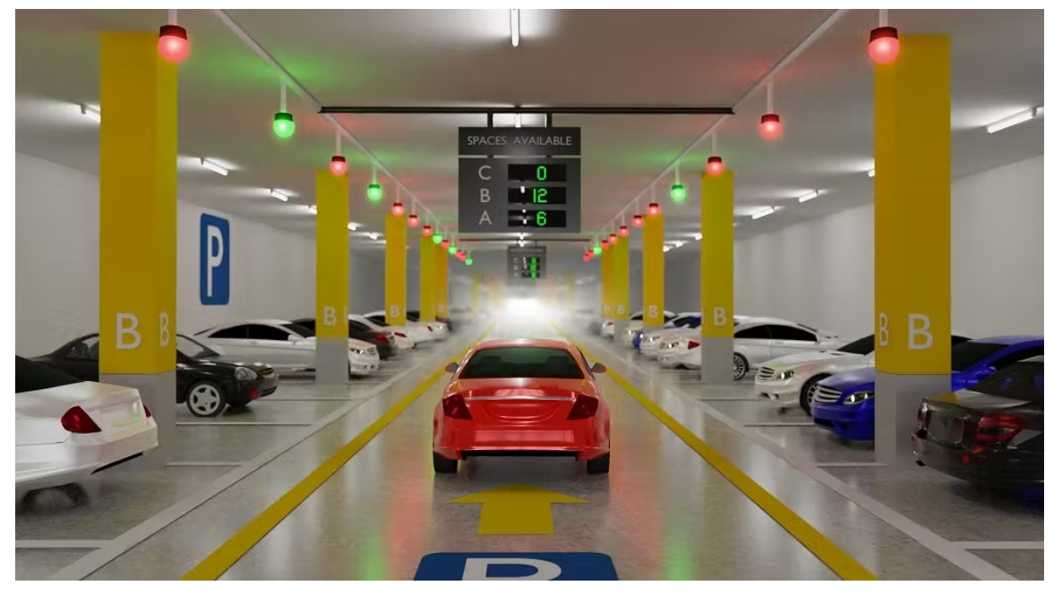
Car parking slot : means an individual parking space
for one car.
We use the laptop as a local server using XAMPP, helps a local host or server to test its website and clients via computers and laptops before releasing it to the main server using PHP code and MySQL databases.

Slide 73
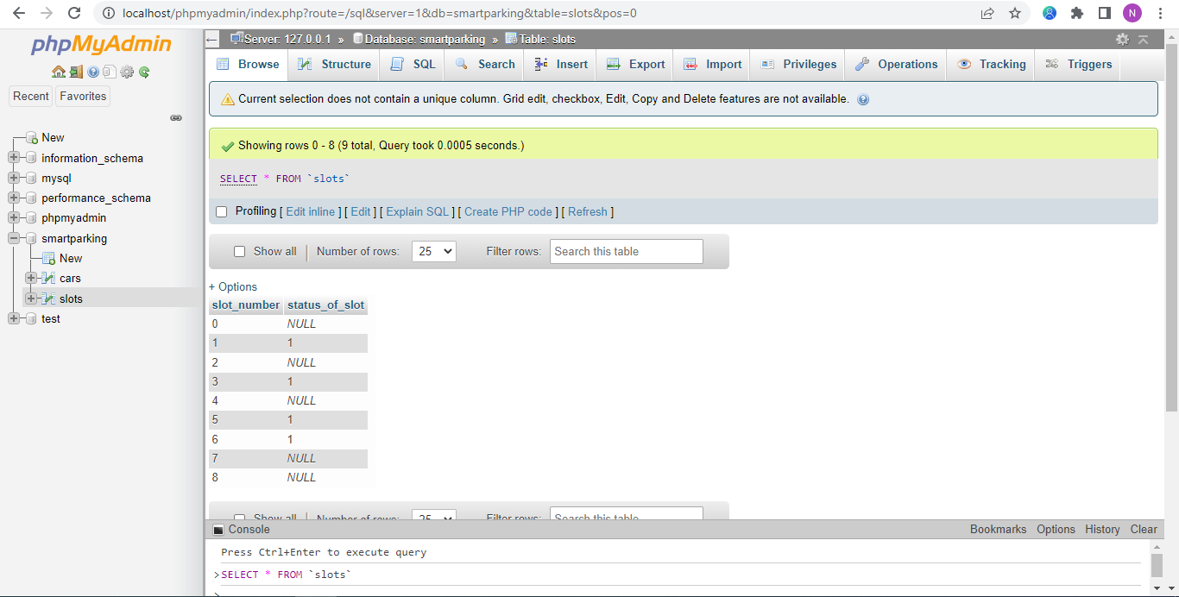
implemented Slot Database.

Slide 74

There ara two APIs that can express the condition of slots
1) Slot Entry 2) Slot Exit
The Third API: slot Entry
When the frontend sends a http request to the URL (path)( http://localhost/smartparking/api/slotEntry.php?slot_number={slotNumber}), its method is (GET) and this[happen when the car owner need to enter]to read slot number the slot Number variable which get by ultrasonic), we send back “data” as a response to the frontend in order to use it.

Slide 75

before receiving the data:
When put the url in the browser and press enter, the data will be transferred to the database.

Slide 76

After receiving the data:

Slide 77

Backend and Frontend in Entry page:
The main purposes of the backend side is to connect to database
and receive the data (free or busy locations) from embedded device in the top of the parking and save it and send it back to the frontend so we can use it.
The main purpose of the frontend side is to keep information organized.
The fourth API: slot Exit

Slide 78
When the frontend sends a http request to the URL (path) (http://localhost/smartparking/api/slotExit.php?slot_number={slotNumber} ), its method is (GET) and this[ happen when the car owner need to exit] to get the slot free, we send back “data” as a response to the frontend in order to use it.
before receiving the data:

Slide 79
When put the url in the browser and press enter, the data will be transferred to the database.
After receiving the data:

Slide 80
Our Website at the end:
There are 4 pages in the website:
1. Start page: which shows how to go to the Services , Help and Contact pages.

Slide 81
2 .Services page: which shows the free and busy locations when owner’s car clicks the Entry button. and shows the time taken and the money to be paid when car’s owner clicks the Exit button.

Slide 82

when owner’s car clicks the Entry button

Slide 83

3.Help page:

Slide 84

4. Contact page:

Slide 85
Future Work
Finally, and after we explained in details what is the idea and implementation of the project are, we would like to assure the importance of smart garages.
There are three technologies that we can add
1) Accurate Data
2) External payment system
3) 3D hologram

